Slide 1
GitHub Copilot GenAI Hackathon
Presenters: Prasanna Dharmana and Pallavi Daga
Team: The Copilot Compilers
Pallavi Daga
Prasanna Dharmana
Faizuddin Shaik
Deepa Kalkunte

Slide 2
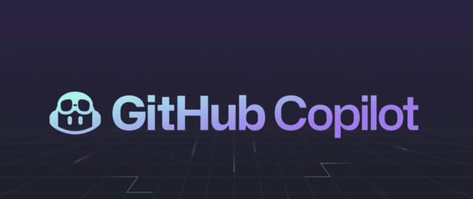
GitHub Copilot GenAI Hackathon
GitHub Copilot: AI pair programmer, boosts productivity & code quality
Leverages OpenAI Codex, trained on billions of lines of code
Real-time code suggestions, completions, & entire functions
Supports multiple languages & frameworks
Improves developer experience, reduces repetitive tasks

Slide 3
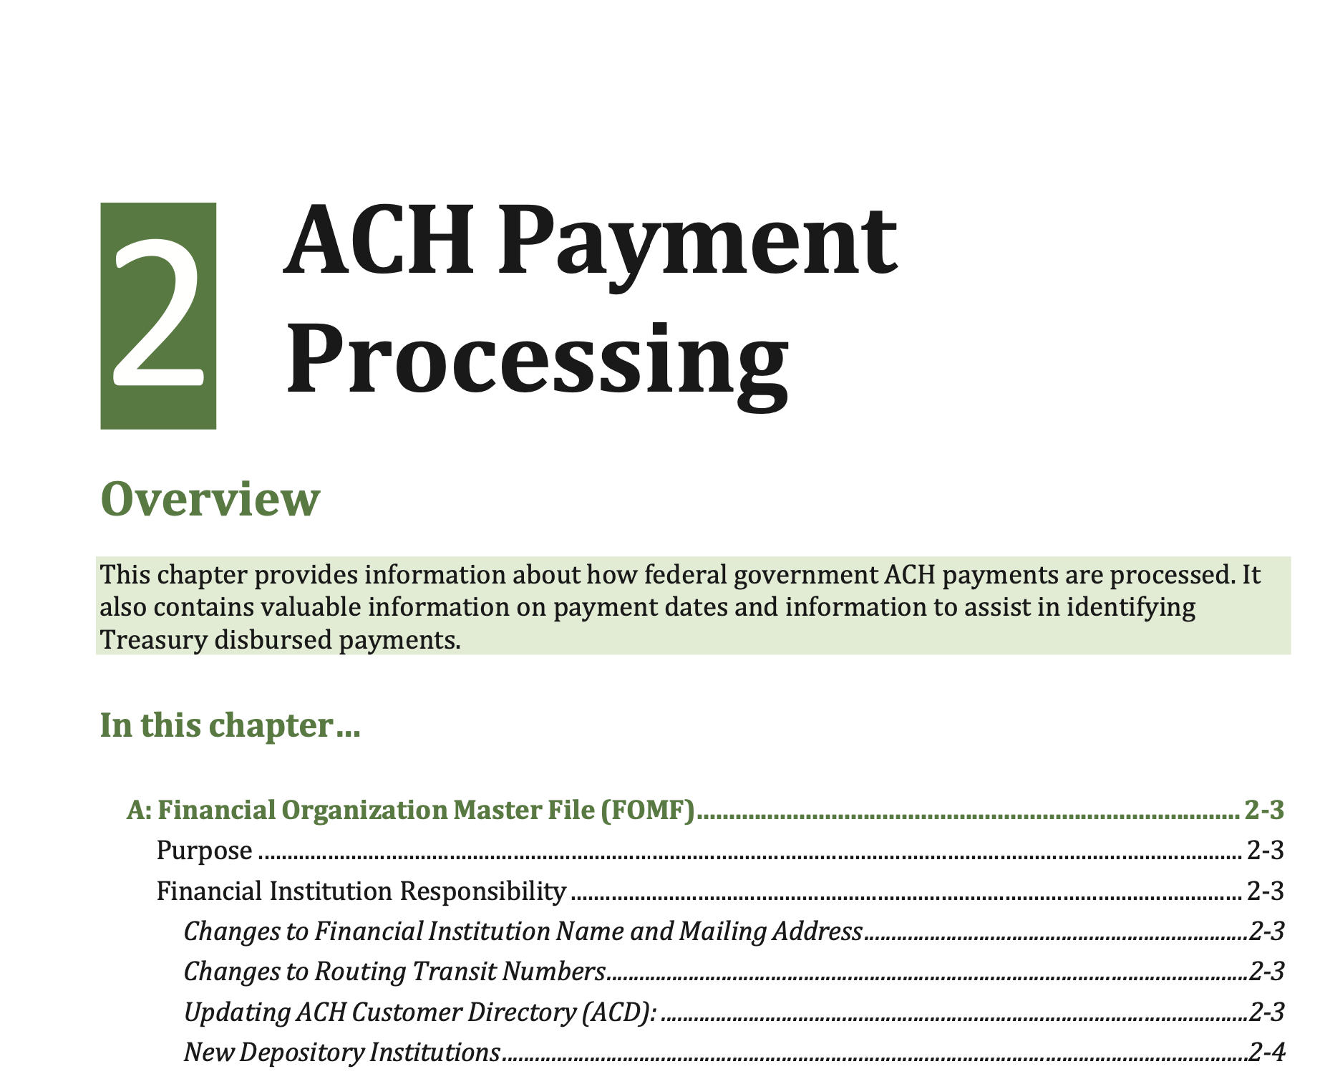
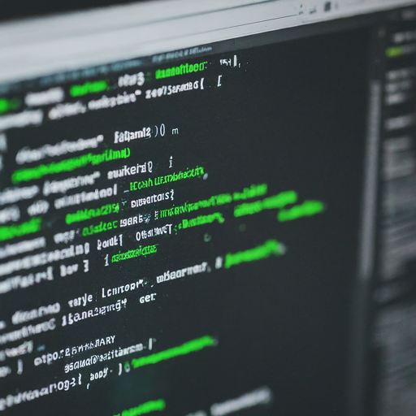
The Copilot Compilers: Let’s gain some domain knowledge
Persona: New hire- Senior Software Engineer
I am senior software engineer, new hire at Discover. I have 10+ years of experience in developing backend services in various programming languages in healthcare industry. I am new to the banking domain and money movement area. I want to learn about domain regulations and process in money movement as a part of my onboarding journey.

Slide 4

Solution Overview
1. Embedding Model: Created using OpenAI and LangChain to scan ACH documents.
2. Deployment: Deployed model to an endpoint using a GitHub codebase.
3. Domain Knowledge: Developed a GitHub agent/extension for domain-specific insights.
4. Code Generation: Utilized GitHub Copilot for code generation for #1 and #2

Slide 5
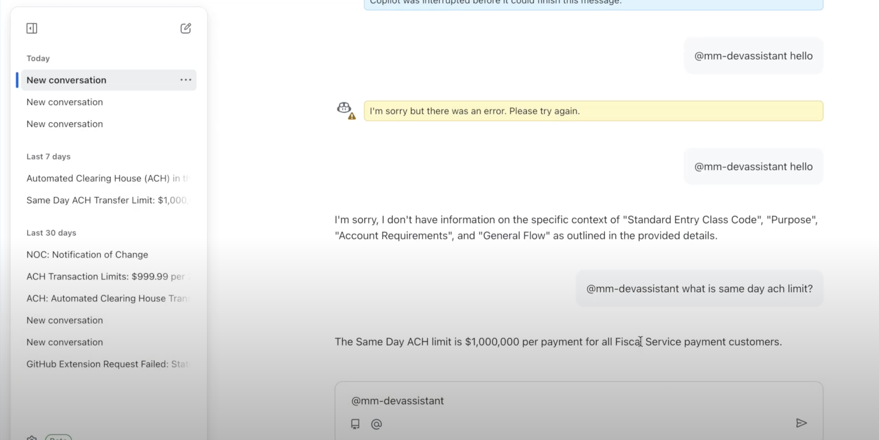
Meet mm-devassistant Copilot Agent/ Extension

Slide 6
High-level Architecture
Github Copilot Extension
Compiler Node App
Copilot Notebook Flask App
LLM

Slide 7
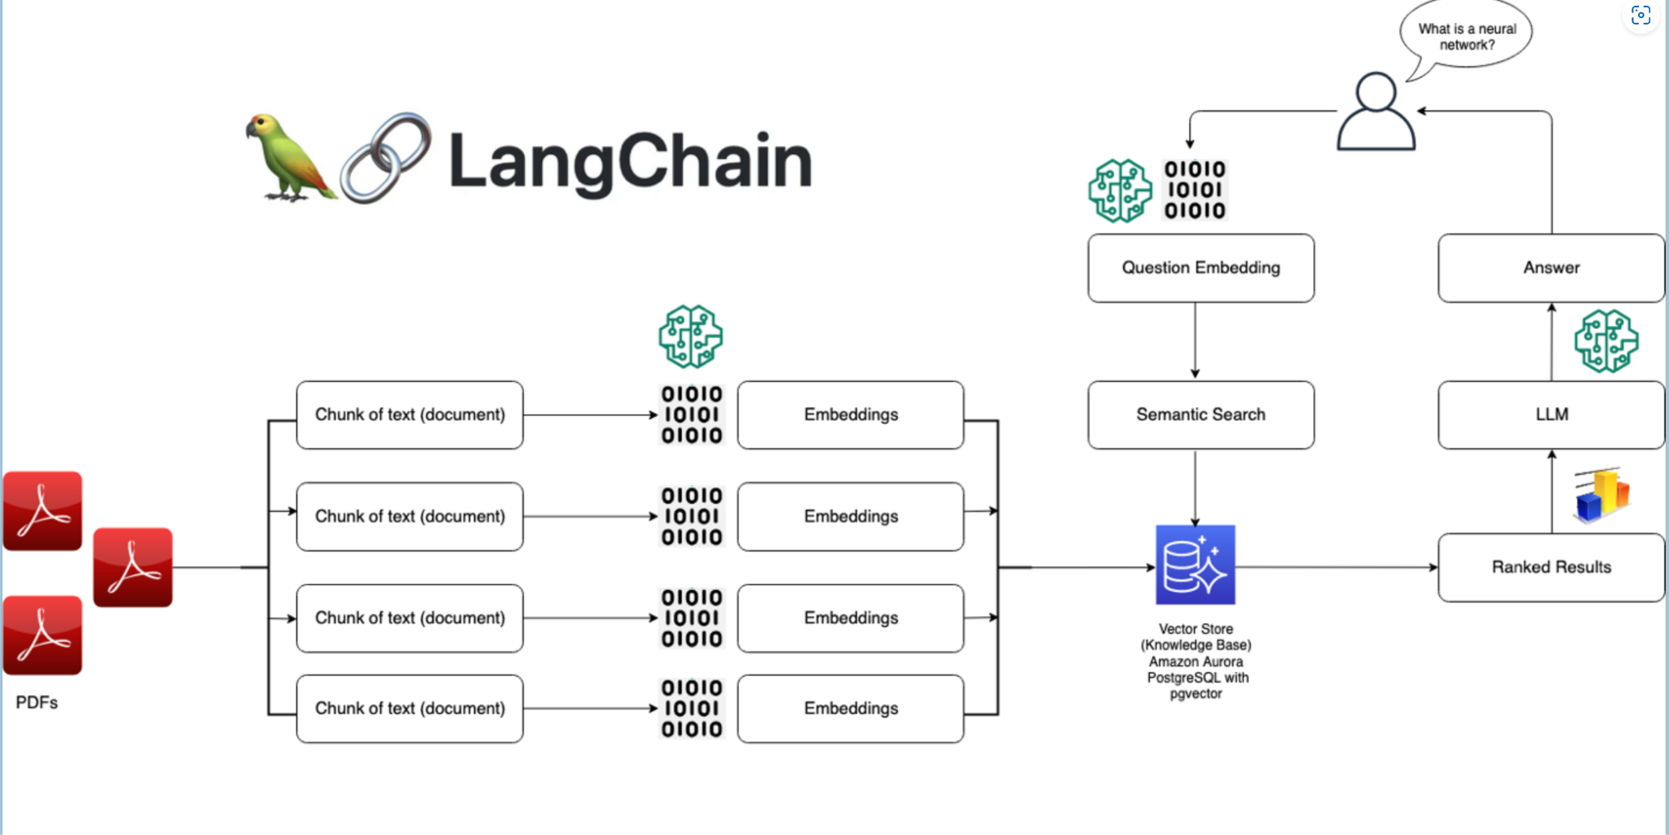
LangChain Architecture

Slide 8

Future Usage in Discover
Build in internal tools to help new hires to learn about Discover knowledge
E.g. Domain knowledge, compliance regulations, policies…possibilities are endless
Integrate copilot custom agent in development Integrated Development Environments (IDE like Visual Studio Code)
Make this available to new hires and teams during onboarding process.

